Slide 1
Installing Git on Windows
Using Cygwin
Blake Bourque
10/7/15

Slide 2
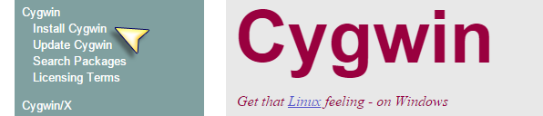
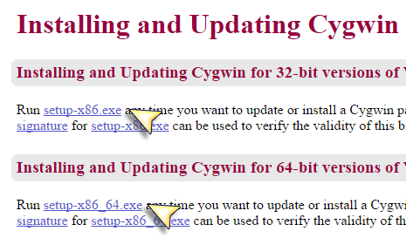
Download & Run the Installer
Go to https://cygwin.com/
Click “Install Cygwin” from the sidebar
Choose setup-x86.exe for 32bit
Choose setup-x86_64.exe for 64bit
Double click the installer once the download completes.

Slide 3
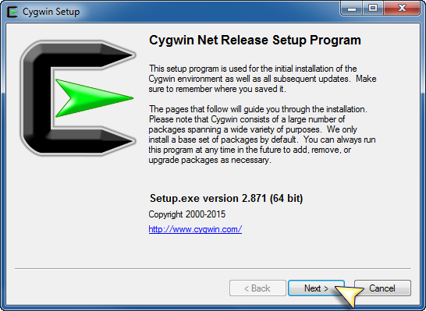
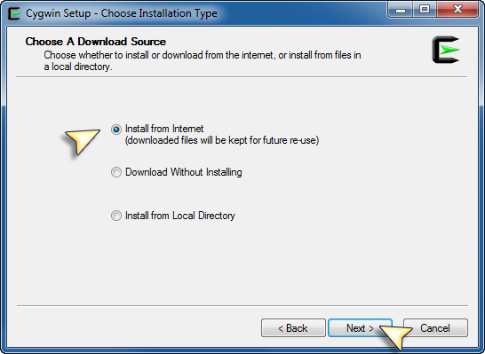
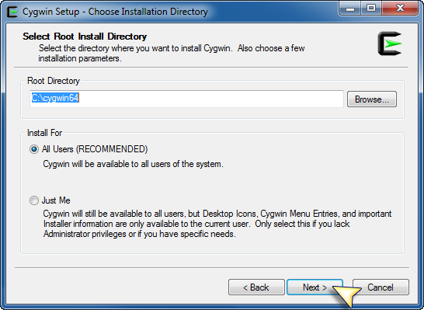
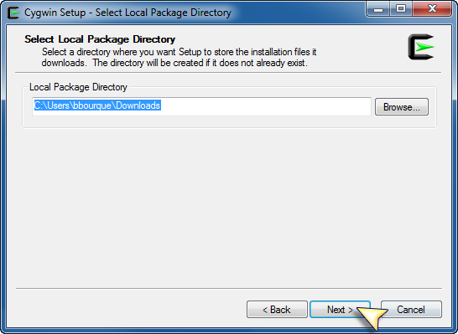
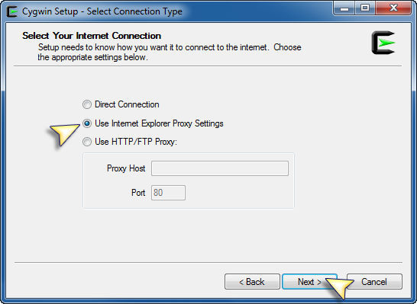
The “Next-athon”

Slide 4
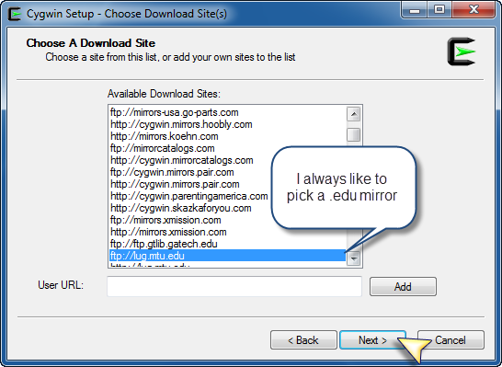
Choosing a Mirror
I prefer a .edu mirror.
You might get an error about the mirror being out of date. Just choose another.

Slide 5
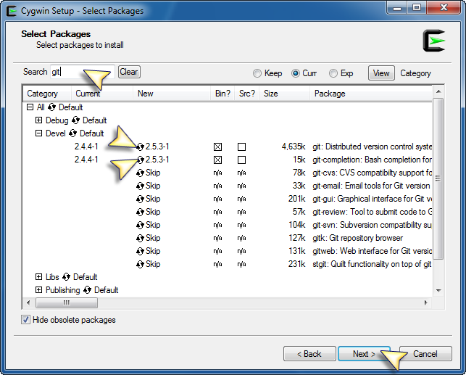
Selecting Packages
Type “git” in the search field
Click to select the package for install
We need to install both:
git
git-completion
Once both packages are selected, click Next > to begin the install

Slide 6
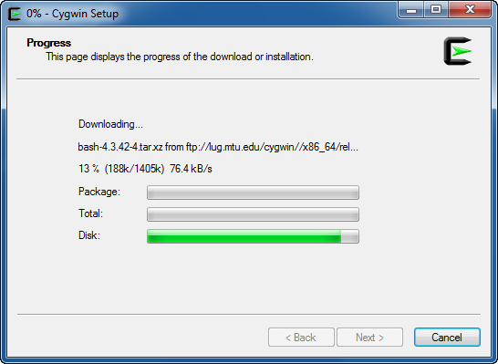
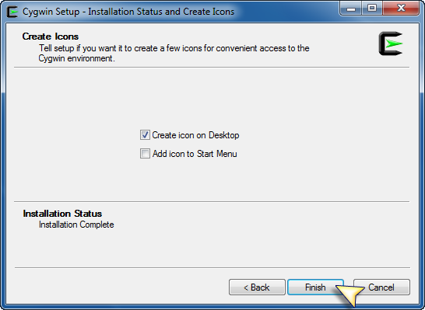
Installing Packages
zvz

Slide 7

Done
Once the install completes you’ll have a new shortcut

